Slide 1

ABC Call Volume Trend Analysis
SAHIL SAVALIYA

Slide 2
Project Description
Analysis is done on following points:-
1. Average Call Duration
2. Call Volume Analysis
3. Manpower Planning
4. Night Shift Manpower Planning
Tech Stack used: -Microsoft Excel

Slide 3
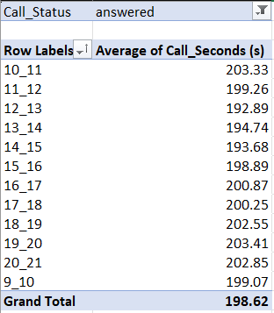
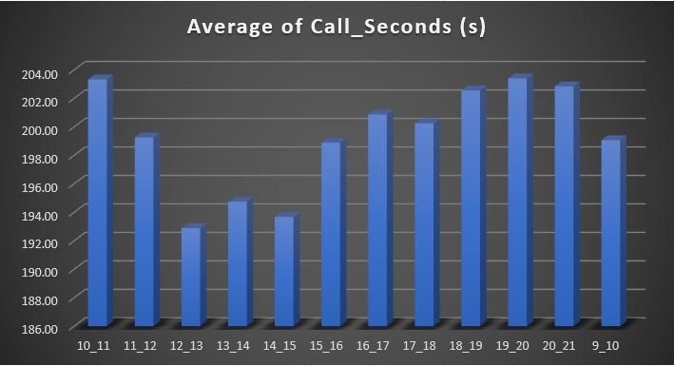
Average Call Duration
Task1: What is the average duration of calls for each time bucket?

Slide 4
Average Call Duration
Insights:-
In the given Analysis scenario Time_Bucket measured in Rows section, Average of Call_Seconds (s) measured in Values section, Call_Status measured in Filters section and filtered the Call_Status as answered.
Based on the analysis Total average call duration answered by agents is 198.62 seconds.
Further analysis reveals that maximum average duration of calls for incoming calls is at 10_11 AM and 7_8 PM .
Based on analysis minimum average call duration for incoming calls received by agents is at 12_1 PM.
These insights explains about the distribution of call durations, helping to identify peak and off-peak periods in terms of call handling.

Slide 5
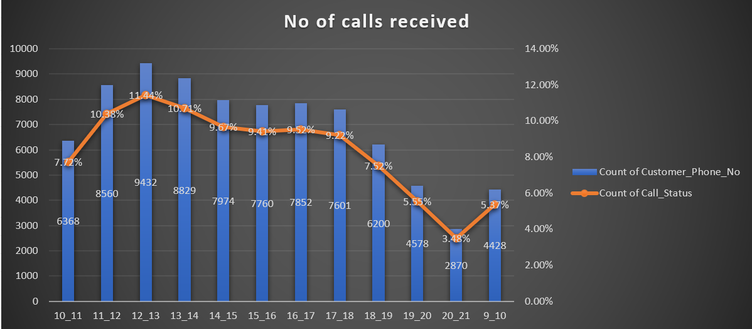
Call Volume Analysis
Task2: Can you create a chart or graph that shows the number of calls received in each time bucket?

Slide 6
Call Volume Analysis
Insights:-
In the given Analysis scenario Time_Bucket measured in Rows section, Count of Customer_Phone_No and Count of Call_Status measured in Values section, Call_Status measured in Filters section.
Then filtered the Call_Status as answered and expressed Count of Call_Status as Percentage of the column total.
Based on analysis highest number of calls received is between 12 PM and 1 PM.
Further analysis also revealed that least number of calls answered is between 8 PM and 9 PM.
These insights provide information about the number of calls received against time, helping to identify peak and off-peak periods.

Slide 7
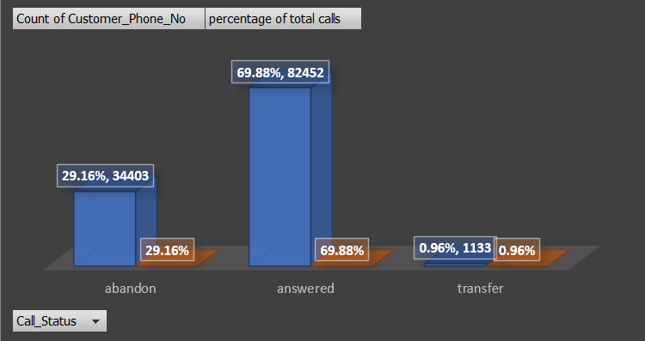
Manpower Planning
Task3: The current rate of abandoned calls is approximately 30%. Propose a plan for manpower allocation during each time bucket (from 9 am to 9 pm) to reduce the abandon rate to 10%. What is the minimum number of agents required in each time bucket to reduce the abandon rate to 10%?
We can see in graph almost 30% calls are getting abandoned.

Slide 8
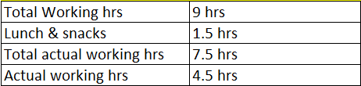
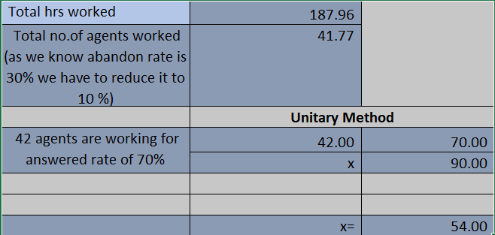

Manpower Planning
Assumption: An agent's total working hours are 9 hours, out of which 1.5 hours are spent on lunch and snacks in the office. On average, an agent spends 60% of their total actual working hours (i.e., 60% of 7.5 hours) on calls with customers/users.
Total Hours worked on 1st Jan

Slide 9
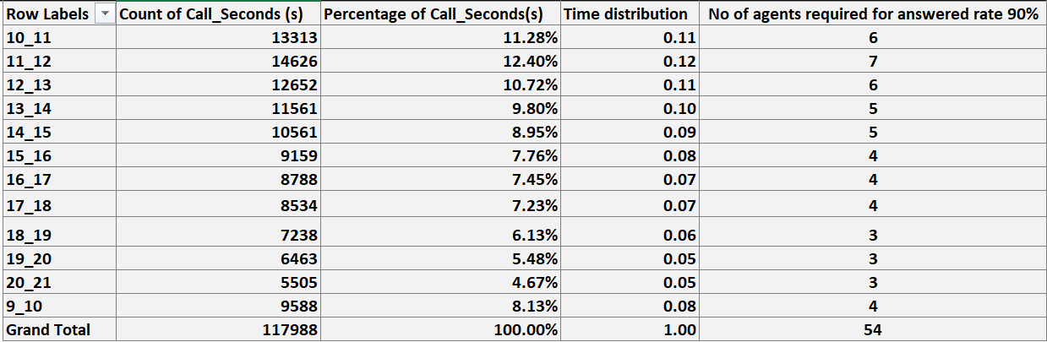
Manpower Planning

Slide 10
Manpower Planning
Insights:-
First I converted Date_&_Time Column in integer and changed the format in MDY and put name of Column as Date_&_Time2.
In given Analysis scenario Date_&_Time2 measured in Rows section, Sum of Call_Seconds (s) measured in Values section
Sum of Call_Seconds (s) on 1-Jan is 676664.
Calculated Total hrs worked using this Formula:
Sum of Call_hours = (Sum of Call_Seconds (s) / 3600) = 187.96 hrs
Based on assumption Actual working hrs per person is 4.5 hrs.
Calculated Total no. of agents worked with answered rate of 70% using this Formula: Total no. of agents worked (70%) = (Total hrs worked / Actual working hrs) = 42

Slide 11
Manpower Planning
Insights:-
Total no. of agents worked with answered rate of 90% using unitary method:
Total no. of agents worked (90%) = (Total no. of agents worked (70%) / 70) * 90 = 54
Total no. of agents required to reduce the abandon rate to 10% is 54.
For Further Analysis,Time_Bucket measured in Rows section, Count of Call_Seconds (s) measured in Values section, expressed Count of Call_Status as Percentage of the column total and Time Distribution by dividing each number of calls distribution by total calls.
To Calculate minimum number of agents required in each time bucket to reduce the abandon rate to 10% using this Formula:
number of agents required in each time bucket = Time distribution * 54
These insights provide information about the minimum number of agents required in each time bucket to reduce the abandon rate to 10%. It will help to optimize staffing resources to ensure efficient customer service and satisfaction.

Slide 12
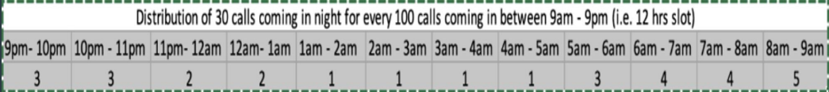
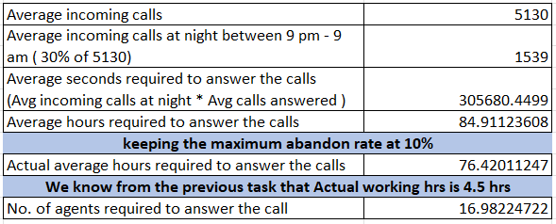
Night Shift Manpower Planning
Task4: Customers also call ABC Insurance Company at night but don't get an answer because there are no agents available. This creates a poor customer experience. Assume that for every 100 calls that customers make between 9 am and 9 pm, they also make 30 calls at night between 9 pm and 9 am. The distribution of these 30 calls is as follows:
Total number of agents required is 17.

Slide 13
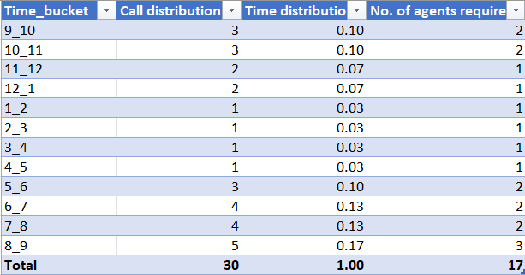
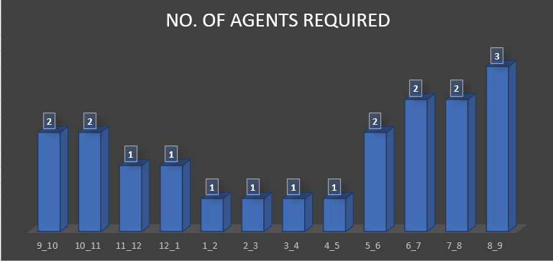
Night Shift Manpower Planning

Slide 14
Night Shift Manpower Planning
Insights:-
Total number of calls for 23 days is 117988.
Average number of calls = (Total number of calls / 23) = 5130
It means Customer make 5130 calls per day.
For every 100 calls that customers make between 9 am and 9 pm, they also make 30 calls at night between 9 pm and 9 am. It means 30% of incoming calls are at night between 9 PM to 9 AM.
Formulas:
Average incoming calls at night between 9 PM - 9 AM = ( 30% of 5130) = 1539
Average seconds required to answer the calls = (Avg incoming calls at night * Avg calls answered) = 1539 * 198.62 = 305680.4499
Average hours required to answer the calls = (Average seconds required to answer the calls / 3600) = 84.9

Slide 15
Night Shift Manpower Planning
Insights:-
keeping the maximum abandon rate at 10%
Actual average hours required to answer the calls = 0.9 * Average hours required to answer the calls = 76.42011247
We know from the previous task that Actual working hrs is 4.5 hrs.
No. of agents required to answer the call = (Actual average hours required to answer the calls /4.5) = 17
Total number of agents required to answer the call at night 9 PM to 9 AM is 17.
Calculated the Time Distribution by dividing each calls distribution by total calls i.e., 30.
The number of agents required for each time bucket is calculated by 17 * Time Distribution.

Slide 16
Conclusions
Company can divide workforce into three shifts to ensure 24/7 availability for addressing customer’s queries and concerns.
Based on analysis incoming calls in evening are less. So Company can optimize workforce by reducing the number of agents in evening for call handling.
Company can hire 17 agents who will be available during night hours from 9 PM to 9 AM to handle the calls or shift some of the day workers to the night shift.
During the analysis there were outliers in data but removing the outliers can lead to different outcomes.
These insights provide the company with actionable strategies for optimizing workforce allocation, enhancing customer service efficiency, and ensuring continuous availability to address customer needs.

